Slide 1
Neural Network
By: Torey Akers
Indiana Wesleyan University

Slide 2
Layers:
Layers work together to refine input data. It transforms the input data into a format that the network can use to make accurate predictions.
The input layer is where raw data is entered
The hidden layer is where data is transformed. Features are transformed into complex patterns or objects.
The output layer produces the networks decision or make a predictions.

Slide 3
Neurons:
Neurons make decisions and work individually with each stage in the network. in a neural network, e ach neuron receives input from the input layer or the pervious layer.
The neuron performs a calculation, and the results are passed to eh neuron in the next layer. The calculations are usually the weighted sum of the inputs.
The results from the calculations are passed to the neuron in the next layer.
Collectively, neurons process and transmit information throughout the network with each neuron contributing to the final output

Slide 4
Weight:
Are adjustable, the weights control how much influence each input has on the neuron decision.
Each connection between the neurons has an associated weight. When data enters the neurons, it is multiplied by the weight to determine the strength of the input.
To minimize the error, the weights are adjusted.
Weights are fine tuned so that the network emphasizes the important inputs while minimizing the impact for the less important inputs.

Slide 5
Activation Functions:
Determines if a neuron should be turned on or remain off. The purpose of the activation functions is to determine which neurons are turned on, which means it signals. Activation functions allow the network to handle nonlinear models
After the neurons completes it weighted sum of it inputs, the activation functions is applied.
ReLU is a common activation function which only has positive inputs or 0

Slide 6
Loss Function:
Is like a test score, the loss function measures how accurately the neural network is performing.
Loss functions compare the neural networks predictions with the actual target value.
If the loss is low suggest that the predictions are accurate.
If the loss is high indicates discrepancies.
The loss function provides feedback to the network, guiding the network through learning by indicating how far off the prediction are from the desired outcome.

Slide 7
Optimization Algorithms:
Is a fine-tuning tool that adjusted the weights step by step to reduce errors.
The algorithm calculates gradient which is the directions of rate of change of the loss functions
Using method like gradient descent, weights are updated iteratively which each iterations aim to move the networks closer to the optimal(best) performance by minimizing the loss

Slide 8
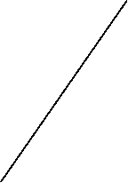


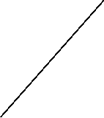
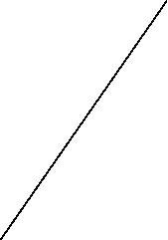

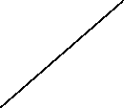


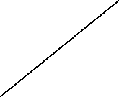



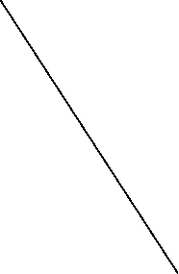



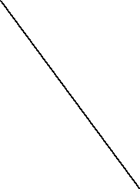


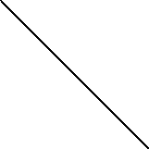
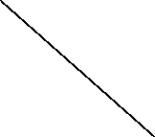


Neural Network
Input Layer
Hidden Layers
Out layer
Output 1
Input 1
Weights
Input 2
Output 2
Input 3
Final
Output
Input
Text
Output 3
Input 4
Activation Function

Slide 9
Summary:
Neural networks are complex and can be hard to comprehend, which is why I believe that visualizations are a necessity. Neural networks use mathematical methods to make decisions or predictions. Having a visual representation of a neural network makes the architecture easier to understand. A visualization allows one to see how data flows through the network—from the input layer, to the hidden activation layers, and finally to the output layer. Visualization makes neural networks more comprehensible.
Visualization can also be used to improve a model’s performance by exposing issues we may overlook, such as overfitting or underfitting patterns, as well as vanishing or exploding gradients.
The key insights that I have obtained from this module are the following:
I have a better understanding of neural network architecture, the components of a neural network, and how those components operate. An example of this is that I now understand that a neural network has an input layer made up of nodes, may have one or more hidden layers that use activation functions, and an output layer that also contains nodes. In the model, there are weights between the nodes that determine how much influence each weight has on the output.
Overall, I have a better understanding of neural network architecture.

